Slide 1


Dept of AIML

Slide 2
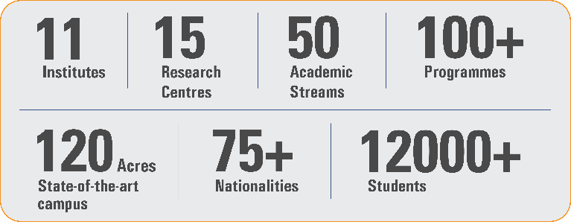
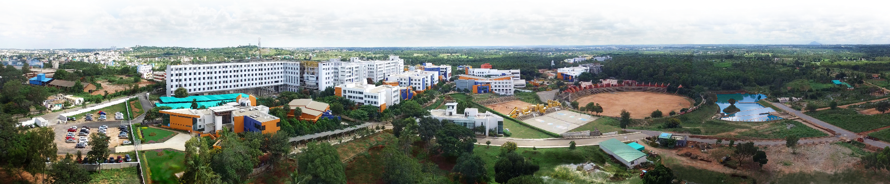
Overveiw
Acharya stands as a beacon of excellence in higher education, boasting a legacy of academic distinction since its establishment in 1990. We offer a transformative educational experience, fostering holistic development, nurturing innovation and providing world-class facilities to ensure an enriching journey for our students.
Dept of AIML

Slide 3
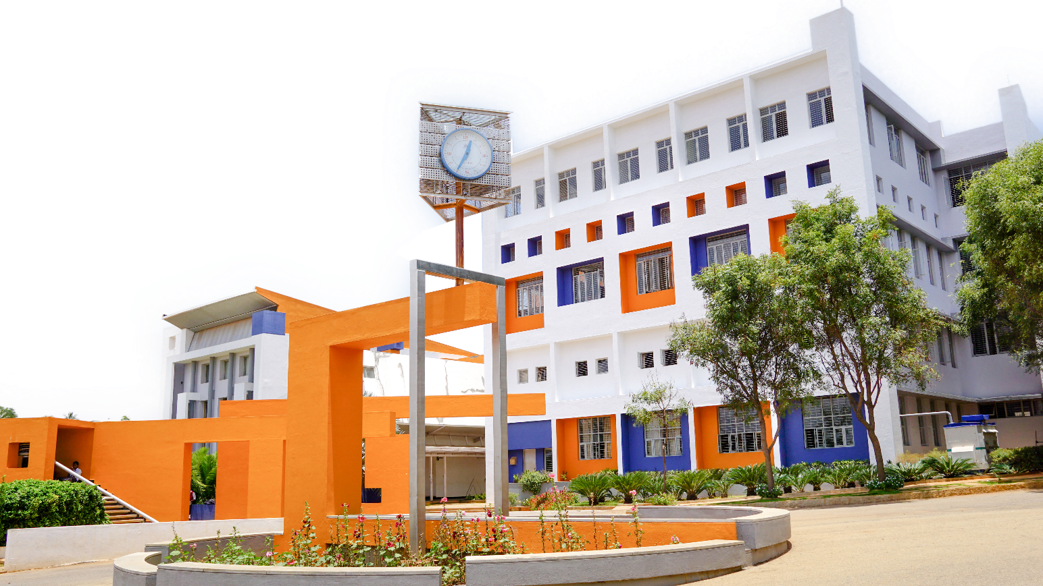
11 Institutions, Infinite Possibilities
We provide 100+ programs across 50 academic streams.
Dept of AIML

Slide 4
Lecture Zero:
DATABASE MANAGEMENT SYSTEM
BCS403
Dept of AIML

Slide 5
DATABASE MANAGEMENT SYSTEM
Course Code BCS403
Teaching Hours/Week (L: T:P: S) 3:0:2:0
Total Hours of Pedagogy 40 hours Theory + 8-10 Lab slots
Credits 04
Dept of AIML

Slide 6
DATABASE MANAGEMENT SYSTEM
Course Learning objectives:
To Provide a strong foundation in database concepts, technology, and practice.
To Practice SQL programming through a variety of database problems.
To Understand the relational database design principles.
To Demonstrate the use of concurrency and transactions in database.
To Design and build database applications for real world problems.
To become familiar with database storage structures and access techniques.
Dept of AIML

Slide 7
DATABASE MANAGEMENT SYSTEM
Teaching Aid:
Chalk + Talk
PPT + Animations
Flipped Class
Software + Simulator
Video Tutorial
Group Discussion/Role Play/ Group Activities
Presentation by Students
Interactive Quizzes/Polls
Case Studies/Real-World Scenarios
Dept of AIML

Slide 8
DATABASE MANAGEMENT SYSTEM
Syllabus(Theory):
Total of 5 modules are there.
Dept of AIML

Slide 9
DATABASE MANAGEMENT SYSTEM
Syllabus(Practical):
There are a total of 7 experiments.
Dept of AIML

Slide 10
DATABASE MANAGEMENT SYSTEM
Assessment Details (both CIE and SEE):
The weightage of Continuous Internal Evaluation (CIE) is 50% and for Semester End Exam (SEE) is 50%.
The minimum passing mark for the CIE is 40% of the maximum marks (20 marks out of 50) and for the SEE minimum passing mark is 35% of the maximum marks (18 out of 50 marks).
A student shall be deemed to have satisfied the academic requirements and earned the credits allotted to each subject/ course if the student secures a minimum of 40% (40 marks out of 100) in the sum total of the CIE (Continuous Internal Evaluation) and SEE (Semester End Examination) taken together.
Dept of AIML

Slide 11
DATABASE MANAGEMENT SYSTEM
Assessment Details (both CIE and SEE):
CIE for the theory component of the IPCC (maximum marks 50)
IPCC means practical portion integrated with the theory of the course.
CIE marks for the theory component are 25 marks and that for the practical component is 25 marks.
25 marks for the theory component are split into 15 marks for two Internal Assessment Tests (Two Tests, each of 15 Marks with 01-hour duration, are to be conducted) and 10 marks for other assessment methods mentioned in 22OB4.2. The first test at the end of 40-50% coverage of the syllabus and the second test after covering 85-90% of the syllabus.
Scaled-down marks of the sum of two tests and other assessment methods will be CIE marks for the theory component of IPCC (that is for 25 marks).
Dept of AIML

Slide 12
DATABASE MANAGEMENT SYSTEM
Assessment Details (both CIE and SEE):
CIE for the practical component of the IPCC
15 marks for the conduction of the experiment and preparation of laboratory record, and 10 marks for the test to be conducted after the completion of all the laboratory sessions.
On completion of every experiment/program in the laboratory, the students shall be evaluated including viva-voce and marks shall be awarded on the same day.
The CIE marks awarded in the case of the Practical component shall be based on the continuous evaluation of the laboratory report. Each experiment report can be evaluated for 10 marks. Marks of all experiments’ write-ups are added and scaled down to 15 marks.
The laboratory test (duration 02/03 hours) after completion of all the experiments shall be conducted for 50 marks and scaled down to 10 marks.
Scaled-down marks of write-up evaluations and tests added will be CIE marks for the laboratory component of IPCC for 25 marks.
The student has to secure 40% of 25 marks to qualify in the CIE of the practical component of the IPCC.
Dept of AIML

Slide 13
DATABASE MANAGEMENT SYSTEM
Assessment Details (CIE):
SEE for IPCC
Theory SEE will be conducted by University as per the scheduled timetable, with common question papers for the course (duration 03 hours)
The question paper will have ten questions. Each question is set for 20 marks.
There will be 2 questions from each module. Each of the two questions under a module (with a maximum of 3 sub- questions), should have a mix of topics under that module.
The students have to answer 5 full questions, selecting one full question from each module.
Marks scored by the student shall be proportionally scaled down to 50 Marks
Dept of AIML

Slide 14
DATABASE MANAGEMENT SYSTEM
The theory portion of the IPCC shall be for both CIE and SEE, whereas the practical portion will have a CIE component only. Questions mentioned in the SEE paper may include questions from the practical component.
Dept of AIML

Slide 15
DATABASE MANAGEMENT SYSTEM
Suggested Learning Resources:
Text Books:
Book 1: Fundamentals of Database Systems, Ramez Elmasri and Shamkant B. Navathe, 7th Edition, 2017, Pearson.
Book 2: Database management systems, Ramakrishnan, and Gehrke, 3rd Edition, 2014, McGraw Hill
Dept of AIML

Slide 16
DATABASE MANAGEMENT SYSTEM
Suggested Learning Resources:
Activity Based Learning (Suggested Activities in Class)/ Practical Based learning Mini Project:
Project Based Learning
Dept of AIML

Slide 17
DATABASE MANAGEMENT SYSTEM
Data is a collection of facts and Figures that can be processed tp produce information
Database is a collection of related data organized in a way that the data can be easily accessed, managed and updated.
Database is a container where data can be collected systematically.
Ex: Online library.
Dept of AIML

Slide 18
DATABASE MANAGEMENT SYSTEM
Why database came:
Data Storage Technique:
Books and file system
Flat file system
Database
DBMS is basically a software where you can store, retrieve define and manage your data in a database.
DBMS is a software that allows user to interact with a database

Slide 19
DATABASE MANAGEMENT SYSTEM
Types of DBMS
Relational DBMS (RDBMS): Organizes data in tables using rows and columns. RDBMSs use a predefined schema and SQL to create, update, and delete data.
Object-Oriented DBMS (OODBMS): Stores data as objects instead of tables. OODBs are based on object-oriented programming (OOP) and are compatible with languages like Java, C++, and Visual Basic.
Hierarchical DBMS: Stores data in a tree-like structure, with each record connected to one or more subordinate records.
Network DBMS: Stores data in a web-like structure, with each record connected to multiple other records. Network databases are often used on large digital computers.
Dept of AIML

Slide 20
DATABASE MANAGEMENT SYSTEM
Database System Application
Banking
Airlines
Universities
Credit card transactions
Telecommunications
Finance
Sales
Manufacturing
Human Resource
Dept of AIML

Slide 21
DATABASE MANAGEMENT SYSTEM
Advantages of DBMS
Data Independence
Efficient data access
Data Integrity
Data Consistency
Enables Concurrent access
Ensures Data Recovery
Enable Data Security
Dept of AIML

